Slide 1
Session 1: Introduction
Proposal Writing Camp

Slide 2
Proposal writting camps - THE PROCESS
Monday afternoon and Wednesday
Horizon Europe Overview
Friday
Call/topic decoding and understanding
The Funding and Tenders Portal
Budget and eligible costs
Proposal’s main parts
Implementation
Consortium BUILDING
Impact
Presentations on:
Evaluation of proposals
---------------------------------------
Excellence
Horizontal issues in Horizon Europe
MSCA
ERC Grants
EIC

Slide 3
HORIZON EUROPE – SHORT OVERVIEW
Specific Programme implementing Horizon Europe & EIT*
Exclusive focus on civil applications
Pillar I
Excellent Science
Pillar II
Global Challenges & European Industrial Competitiveness
Pillar III
Innovative Europe
European Research Council
Health
Culture, Creativity & Inclusive Society
Civil Security for Society
Digital, Industry & Space
Climate, Energy & Mobility
Food, Bioeconomy, Natural Resources, Agriculture & Environment
European Innovation Council
Marie Skłodowska-Curie
Clusters
European Innovation Ecosystems
Research Infrastructures
European Institute of Innovation & Technology*
Joint Research Centre
Widening Participation and Strengthening the European Research Area
Widening participation & spreading excellence
Reforming & Enhancing the European R&I system

Slide 4
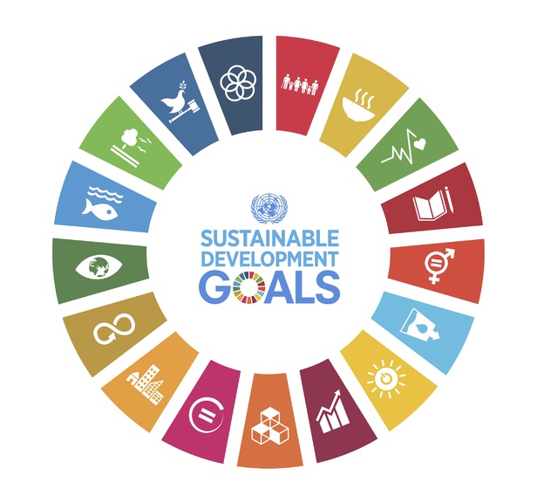
Our Vision
The EU’s key funding programme for research and innovation:
Tackles climate change
Helps to achieve the UN’s Sustainable Development Goals
Boosts the EU’s competitiveness and growth
Facilitates collaboration and strengthens the impact of research and innovation in developing, supporting and implementing EU policies while tackling global challenges
Supports the creation and better diffusion of excellent knowledge and technologies
Creates jobs, fully engages the EU’s talent pool, boosts economic growth, promotes industrial competitiveness and optimises investment impact within a strengthened European Research Area.
Credits: https://www.un.org/sustainabledevelopment/sustainable-development-goals/

Slide 5
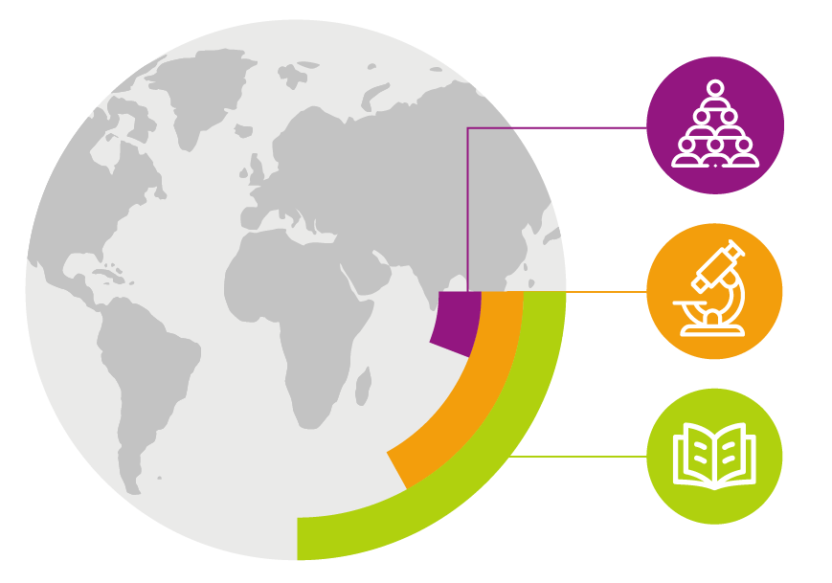
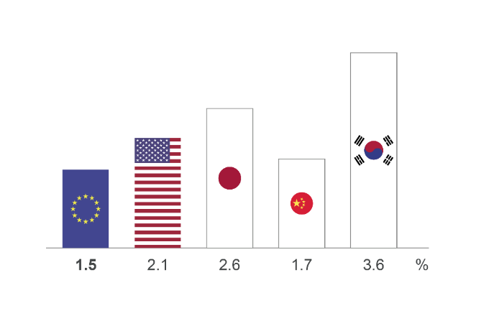
While benefiting from world-class research and strong industries… Our knowledge and skills are our main resources
6% of the world's
population
1.5% EU business R&D investment
17% of global R&D
25% of all high-quality scientific publications
EU figure is for 2019
Figures for USA, Japan, China and South Korea are for 2018. Figures represent R&D as % of GDP
…Europe can do better at transforming this into leadership in innovation and entrepreneurship

Slide 6
Horizon Europe Budget: €95.5 billion (2021-2027)
(including €5.4 billion from NGEU – Next Generation Europe – programme of EU for Recovery from COVID-19 crisis)
Political agreement December 2020
€ billion in current prices

Slide 7
Key Novelties in Horizon Europe
Lessons Learned
from Horizon 2020 Interim Evaluation
Support breakthrough innovation
European Innovation Council
Create more impact through mission-orientation and citizens' involvement
EU Missions
Rationalise partnerships’ landscape
New approach to partnerships
Reinforce openness
Open science policy
Strengthen international cooperation
Extended association possibilities
Encourage participation
Spreading Excellence

Slide 8
EU framework programmes proved powerful for research & innovation impact
1.5 million
Collaborations from more than 150 countries
3X
more often among top 1% cited publications compared to output in Member States
€48.2 million
Directed to coronavirus R&I just seven days after the first EU case reported
84%
of investments address Sustainable Development Goals; 30% address climate change
double
the proposals received per year compared to the previous programme
19%
estimated labour productivity increase in funded companies thanks to the programme*
statistics from Horizon 2020 evaluation and monitoring and *Framework Programme 7 JRC research paper
Notes:
* from ‘The Impact of EU Grants for Research and Innovation on Private Firms’ Performance’ https://ec.europa.eu/research/participants/documents/downloadPublic?documentIds=080166e5c01f3e57&appId=PPGMS
Other statistics:
Horizon 2020 is a highly international and collaborative programme, creating vast networks across countries sectors and disciplines: participants from more than 150 countries take part in the programme and form more than 1.5 million collaborations worldwide;
Horizon 2020 is producing quality results with almost 100 000 EU-funded peer reviewed scientific publications cited more than twice the world average (Field-Weighted Citation Index of 2.3), and 3 times more represented in the world’s top 1% of cited research compared to publication output of EU Member States. 60% of these publications are available in open access enabling a wide diffusion of knowledge and solutions. Since 2009 the Framework Programmes generated more than 10 000 patents with a higher market value than the world average. Overall, 75% of all patents are owned by European entities, over half (52%) of which are SMEs. Most patents are in the areas of biotechnology, pharmaceuticals and organic chemistry.
Horizon 2020 is an attractive programme; the number of proposals received per year doubled compared to the previous Framework Programme. However since EU resources are limited Horizon 2020 has been able to provide funding for only one in eight proposals (success rate of 11.9%). Of every four proposals evaluated as being ‘of high quality’, three could not be funded.
Horizon 2020 is an efficient programme: As a result of simplification efforts grant agreements are now signed 1.7 times faster, taking an average of 184 days as against 313 under FP7. Overall, 89% of grant agreements are signed within the 245-day ‘time to grant’ target7.
Horizon 2020 is a Programme designed with an investment mind-set rather than as a ‘funding’ instrument. It is built to help the EU make the transition towards a sustainable and prosperous future. Horizon 2020 significantly contributes to the achievement of the United Nations Sustainable Development Goals (SDG), with up to 84% of the programme’s investments related to at least one SDG and, 30% of the programme’s investments related to climate action.
Horizon 2020 has shown a great level of flexibility and ability to act fast. The Programme is at the forefront of supporting research and innovation efforts, including preparedness for pandemics: €4.1 billion were invested from 2007 to 2019 on infectious diseases, including initiatives to address antimicrobial resistance, as well as preparedness and emergency response to outbreaks (Ebola, Zika)). On 31 January 2020, seven days after the first COVID-19 case in Europe, EUR 48.2 million were already mobilised through Horizon 2020 to support research on the new coronavirus. As of today, over a billion euros have been committed for this purpose. When research activities are of such a scale and complexity that no single Member State can provide the necessary financial or personnel resources alone, EU R&I programme helps sharing the risks and leveraging sufficiently large investments to generate a critical mass of money and talent to develop solutions, fast.
International cooperation in research and innovation has long been a strategic priority for the EU. With participants from more than 150 countries around the globe Horizon 2020 demonstrates a broad international outreach.

Slide 9
Horizon Europe
The ambitious EU research and innovation framework programme (2021-2027)
fuel EU’s scientific and technological excellence and the strengthen the European Research Area (ERA)
tackle policy priorities, including green and digital transitions and Sustainable Development Goals
boost Europe's innovation uptake, competitiveness and jobs
Science & technology
Society
Economy

Slide 10
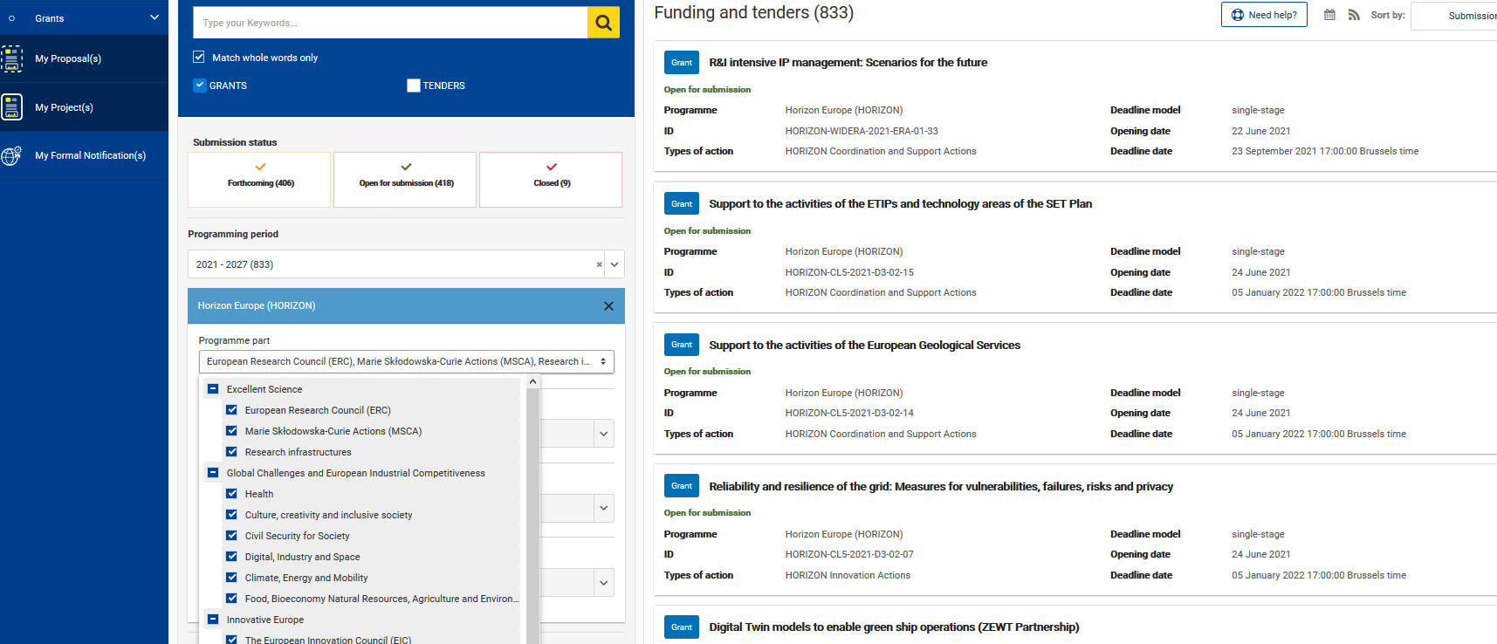
International cooperation in Horizon Europe Work Programme 2021-2022
Funding & Tenders Portal (FTP) – How to find a call? (I)
https://ec.europa.eu/info/funding-tenders/opportunities/portal/screen/home

Slide 11
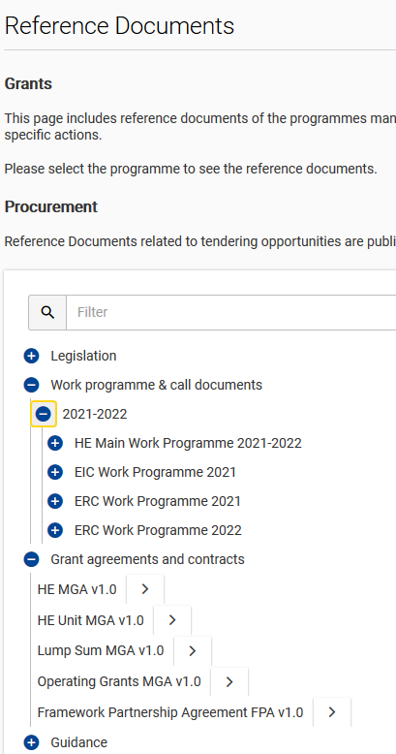
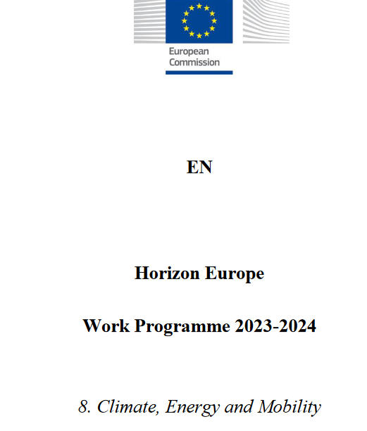
2. How to find a call? (II)
What information do thematic work programmes provide?
International cooperation in Horizon Europe Work Programme 2021-2022
Introduction
Overview of the scheduled call(s)
Description of the topics
Call Key data:
Opening date, deadline
Type of Action (RIA,CSA,IA, etc)
indicative budget per Topic/Call
one-stage/two-stage procedure
indicative date for evaluation outcome & grant signing
Budget
https://ec.europa.eu/info/funding-tenders/opportunities/portal/screen/how-to-participate/reference-documents;programCode=HORIZON

Slide 12
HORIZON EUROPE STRUCTURE
Pillar I
Excellent Science
European Research Council
Marie Skłodowska-Curie
Research Infrastructures
Pillar II
Global Challenges & European Industrial Competitiveness
Health
Culture, Creativity & Inclusive Society
Civil Security for Society
Digital, Industry & Space
Climate, Energy & Mobility
Food, Bioeconomy, Natural Resources, Agriculture & Environment
Joint Research Centre
Pillar III
Innovative Europe
European Innovation Council
European Innovation Ecosystems
European Institute of Innovation & Technology
6 Clusters
Widening Participation and Strengthening the European Research Area
Widening participation & spreading excellence
Reforming & Enhancing the European R&I system

